Slide 1
Death rates in the United States have been declining But what still needs to be done?
Alex D'Agostino, Aidan Copeland, Chance Pickett, Skyler Dickinson

Slide 2
Overview
We looked at causes of death and death rates in the US between 1999 and 2017
We joined data on smoking, obesity, Medicaid, and Medicare to examine:
What is improving?
What is getting worse?
What are we doing now?
What needs to be done?

Slide 3
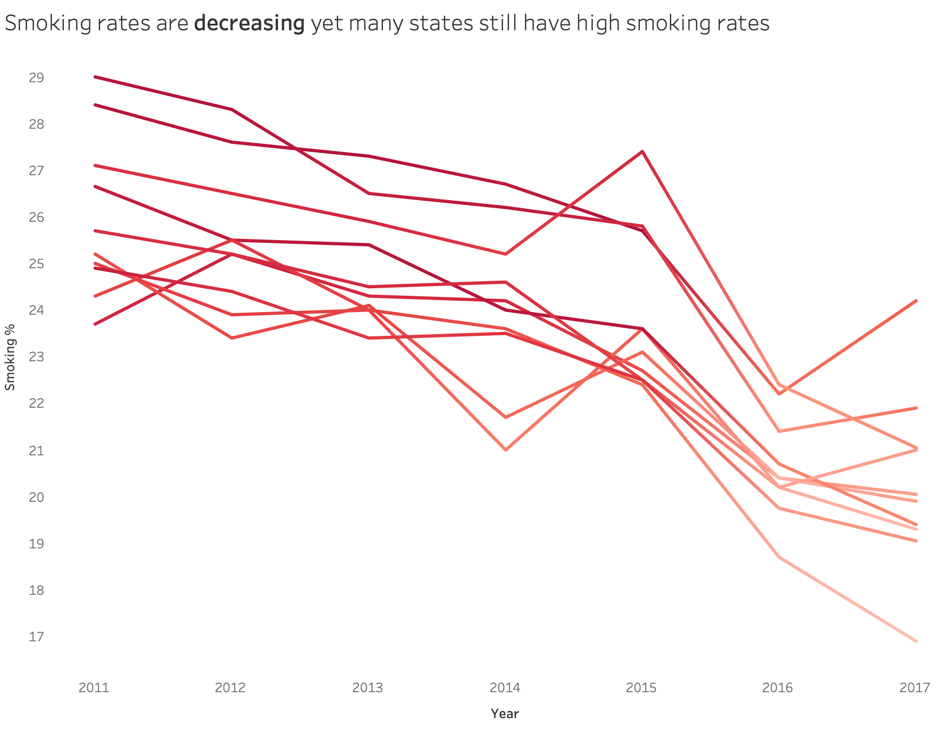
What is improving? Analysis of Smoking
Cigarette smoking rates for the majority of states are decreasing.
Despite that, states like West Virginia and Kentucky still have high smoking rates.
Smoking correlates with multiple causes of death.

Slide 4
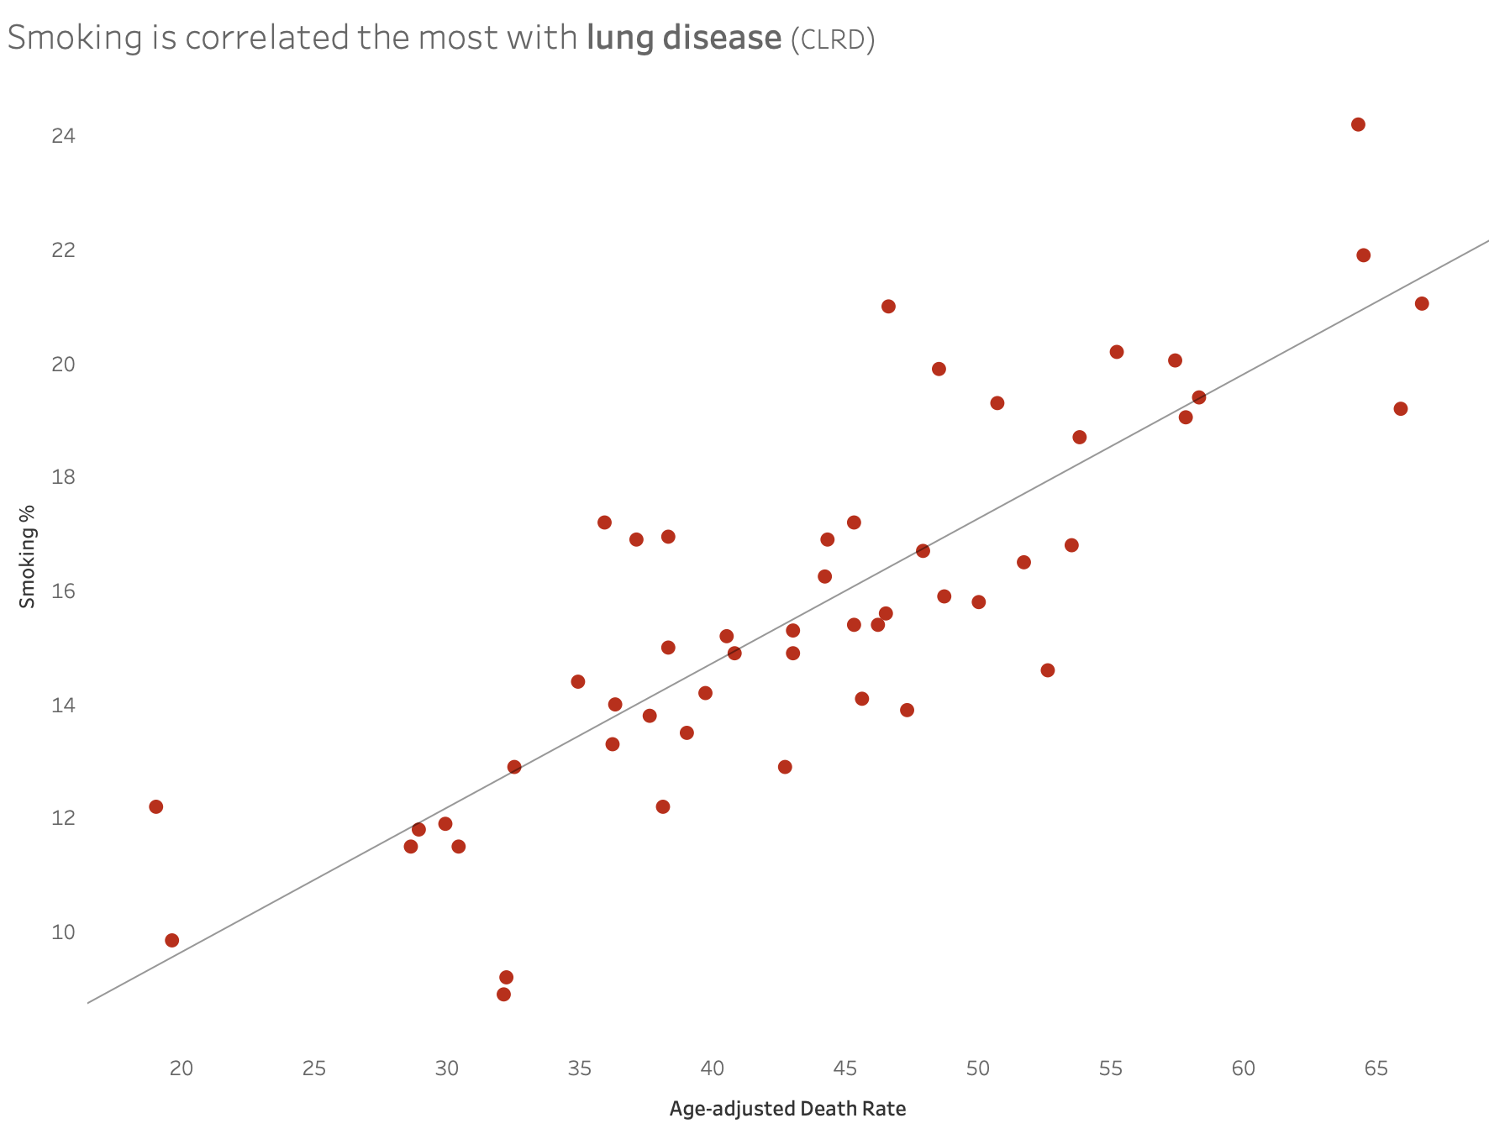
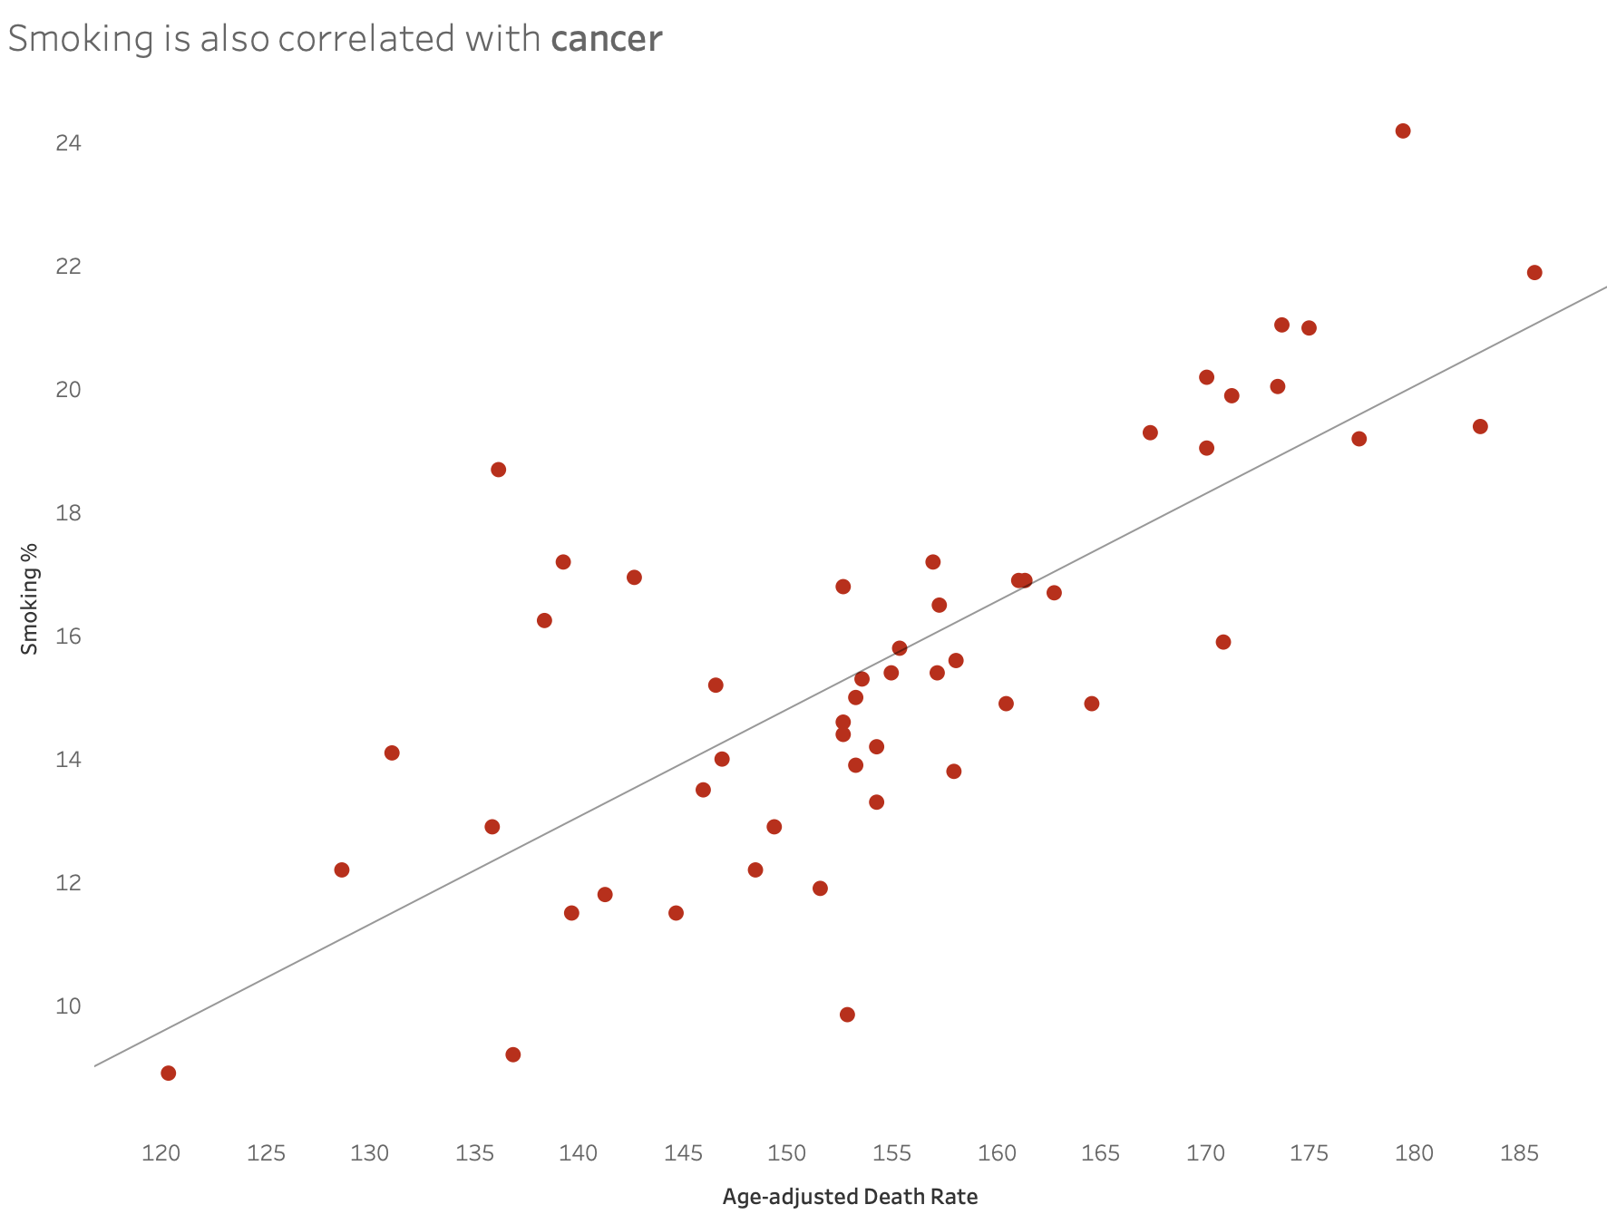
What is improving? Analysis of Smoking
Out of all the death causes, cigarette smoking is correlated with lung disease (CLRD) and cancer the most.
States with lower smoking rates are likely to have less deaths from these causes compared to other death causes
In order to prevent these death causes, campaigns which target these issues should be used to lower the rate of lung disease and cancer.

Slide 5
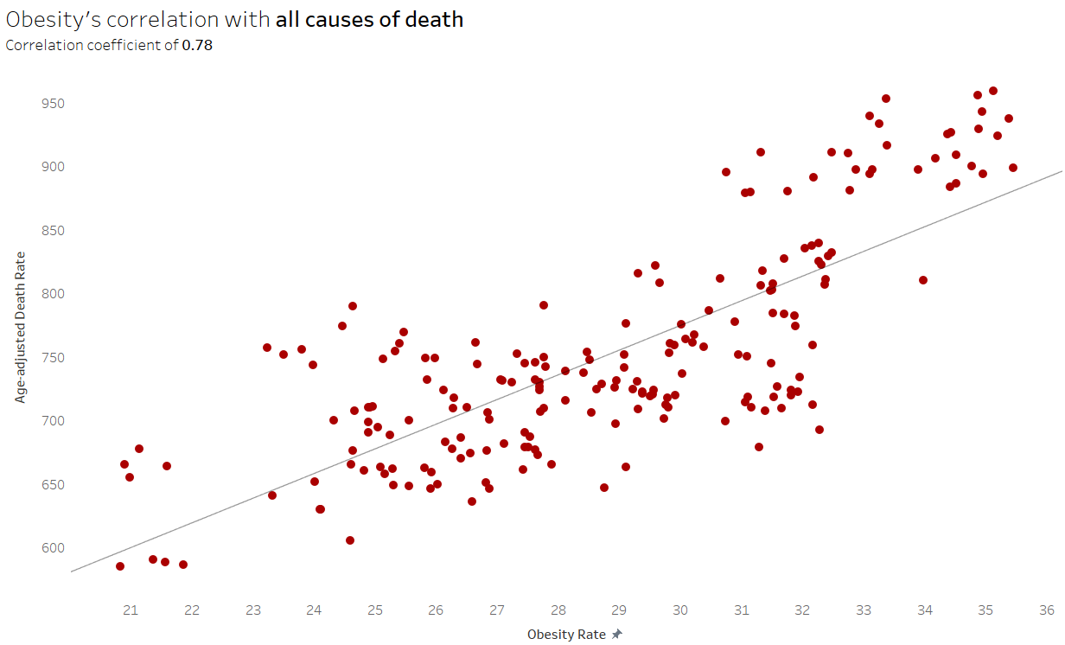
What is getting worse? Analysis of obesity
Obesity is linked to many causes of death
Particularly diabetes, heart disease, stroke, and cancer
Heart disease, cancer, and stroke being the top three causes of death

Slide 6
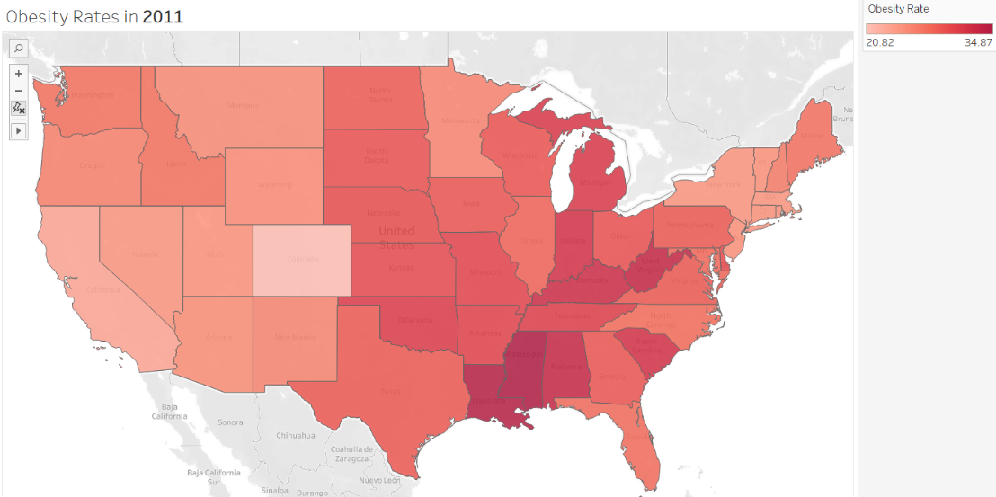
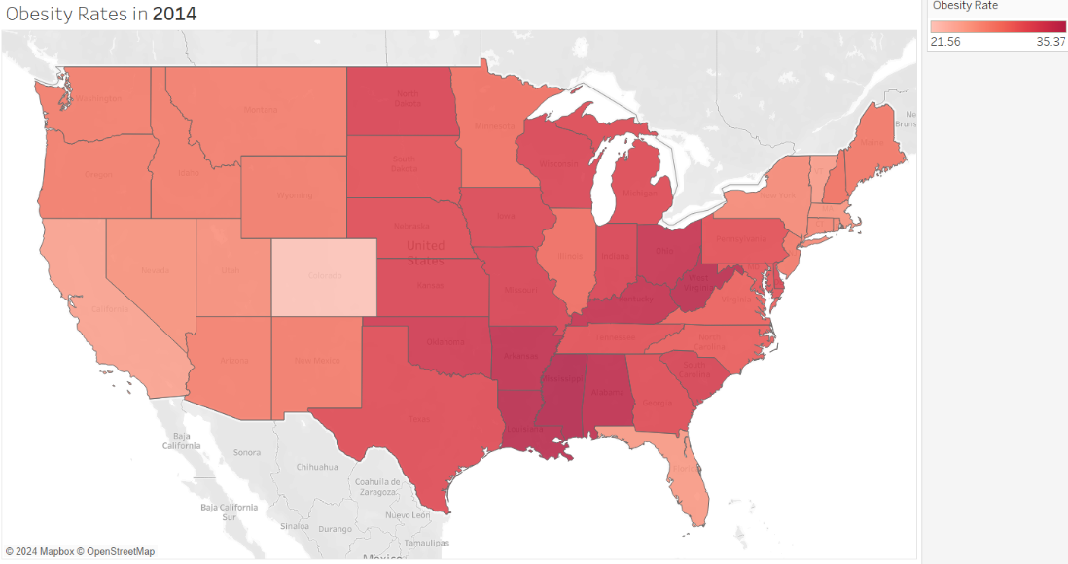
What is getting worse? Rising obesity
-Obesity is rising rapidly across all states
-The South and Midwest have been hit the hardest by this rise
-Food deserts, common in impoverished areas, are a main cause of obesity

Slide 7
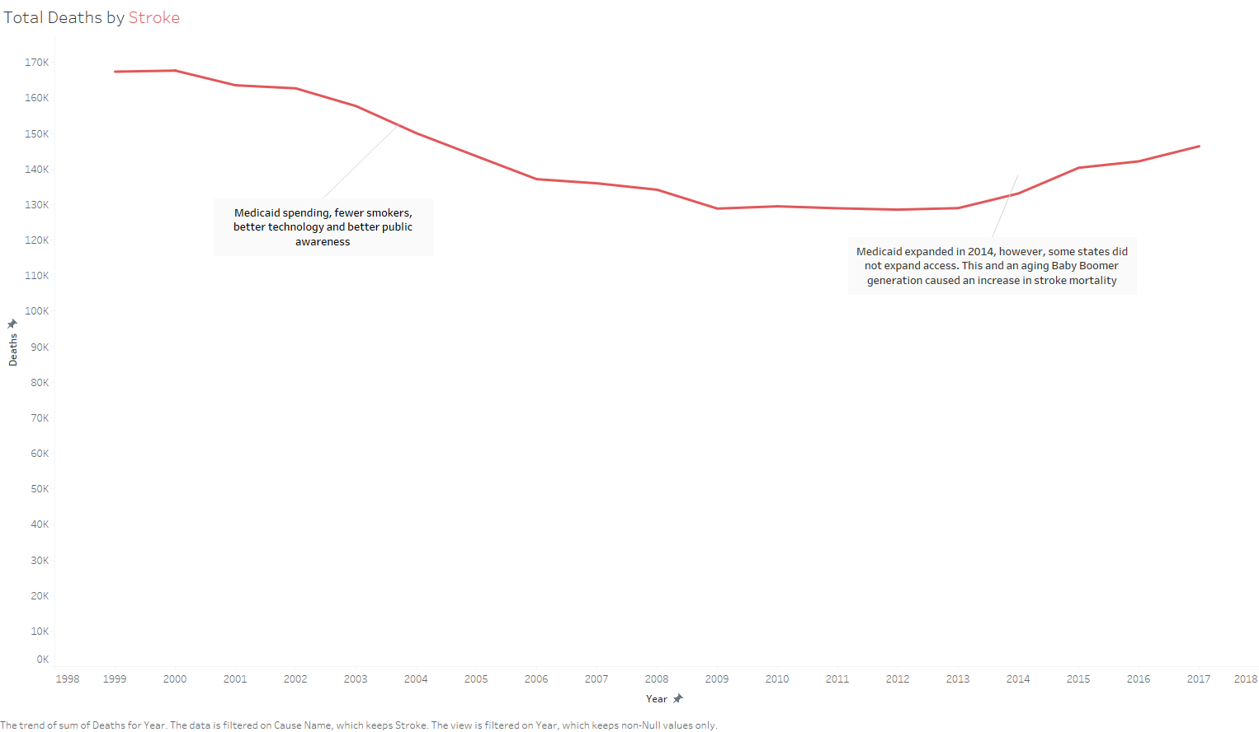
Stroke Deaths
1995-2006: Stroke deaths decreased
2007-2013: Stroke deaths plateau
2014: Medicaid expansion
Notes:
Here we focus on stroke deaths between 1999 and 2017. From 1999 to 2006, we saw a clear decline in stroke-related deaths, which plateaued between 2007 and 2013.
This decline was driven by advancements in short term stroke care, fewer smokers
However, starting in 2014, we see a slight uptick in deaths. This coincides with Medicaid expansion under the ACA, but the rise may also reflect challenges like the aging Baby Boomer population and persistent disparities in access to preventative care.

Slide 8
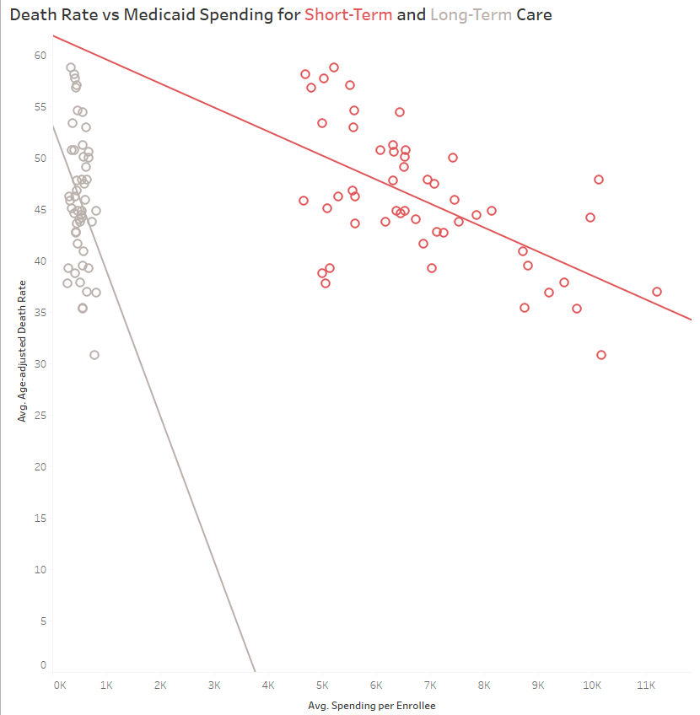
Spending Allocation
Negative Correlation
Short–Term Care
Hospital Services, Acute Treatment
r = 0.59
Clearly defined
Timely treatment
Long-Term Care
Nursing Homes, Durable Medical Products
r = 0.28
Other factors
Notes:
This slide explores the relationship between Medicaid spending and age-adjusted death rates by type of care. We compare short-term care, such as hospital services and acute treatments, with long-term care, including nursing homes and durable medical products.
Short-term care spending shows a much stronger negative correlation with death rates, indicating that timely treatment has a clear impact on reducing mortality.
Long-term care, while beneficial, is influenced by other factors and shows a weaker correlation. This data suggests that targeted investment in acute care might yield the most immediate health outcomes.
indicating that timely treatment has a clear impact on reducing mortality.

Slide 9
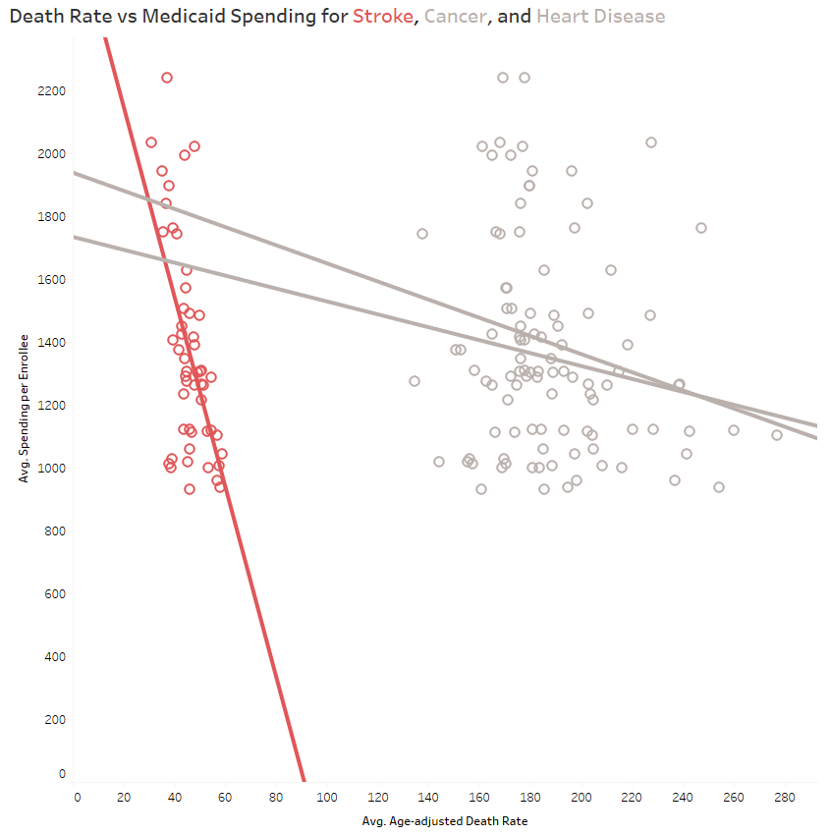
Impact of Medicaid Spending for Stroke, Cancer, and Heart Disease
Stroke has strongest correlation
Preventative care and timely treatment drive Medicaid success
Chronic, multifactorial conditions require long term investment
Notes:
Here we compare Medicaid spending per enrollee with death rates for strokes, cancer, and heart disease.
Strokes show the strongest correlation, where higher spending is clearly associated with lower death rates. This demonstrates Medicaid’s success in funding preventative care and timely treatments for strokes
In contrast, cancer and heart disease show weaker correlations, reflecting their complex nature. These conditions require long-term investment in both chronic disease management and broader societal interventions.
The data hihglights the need for tailored spending strategies based on the unique characteristics of each condition.

Slide 10
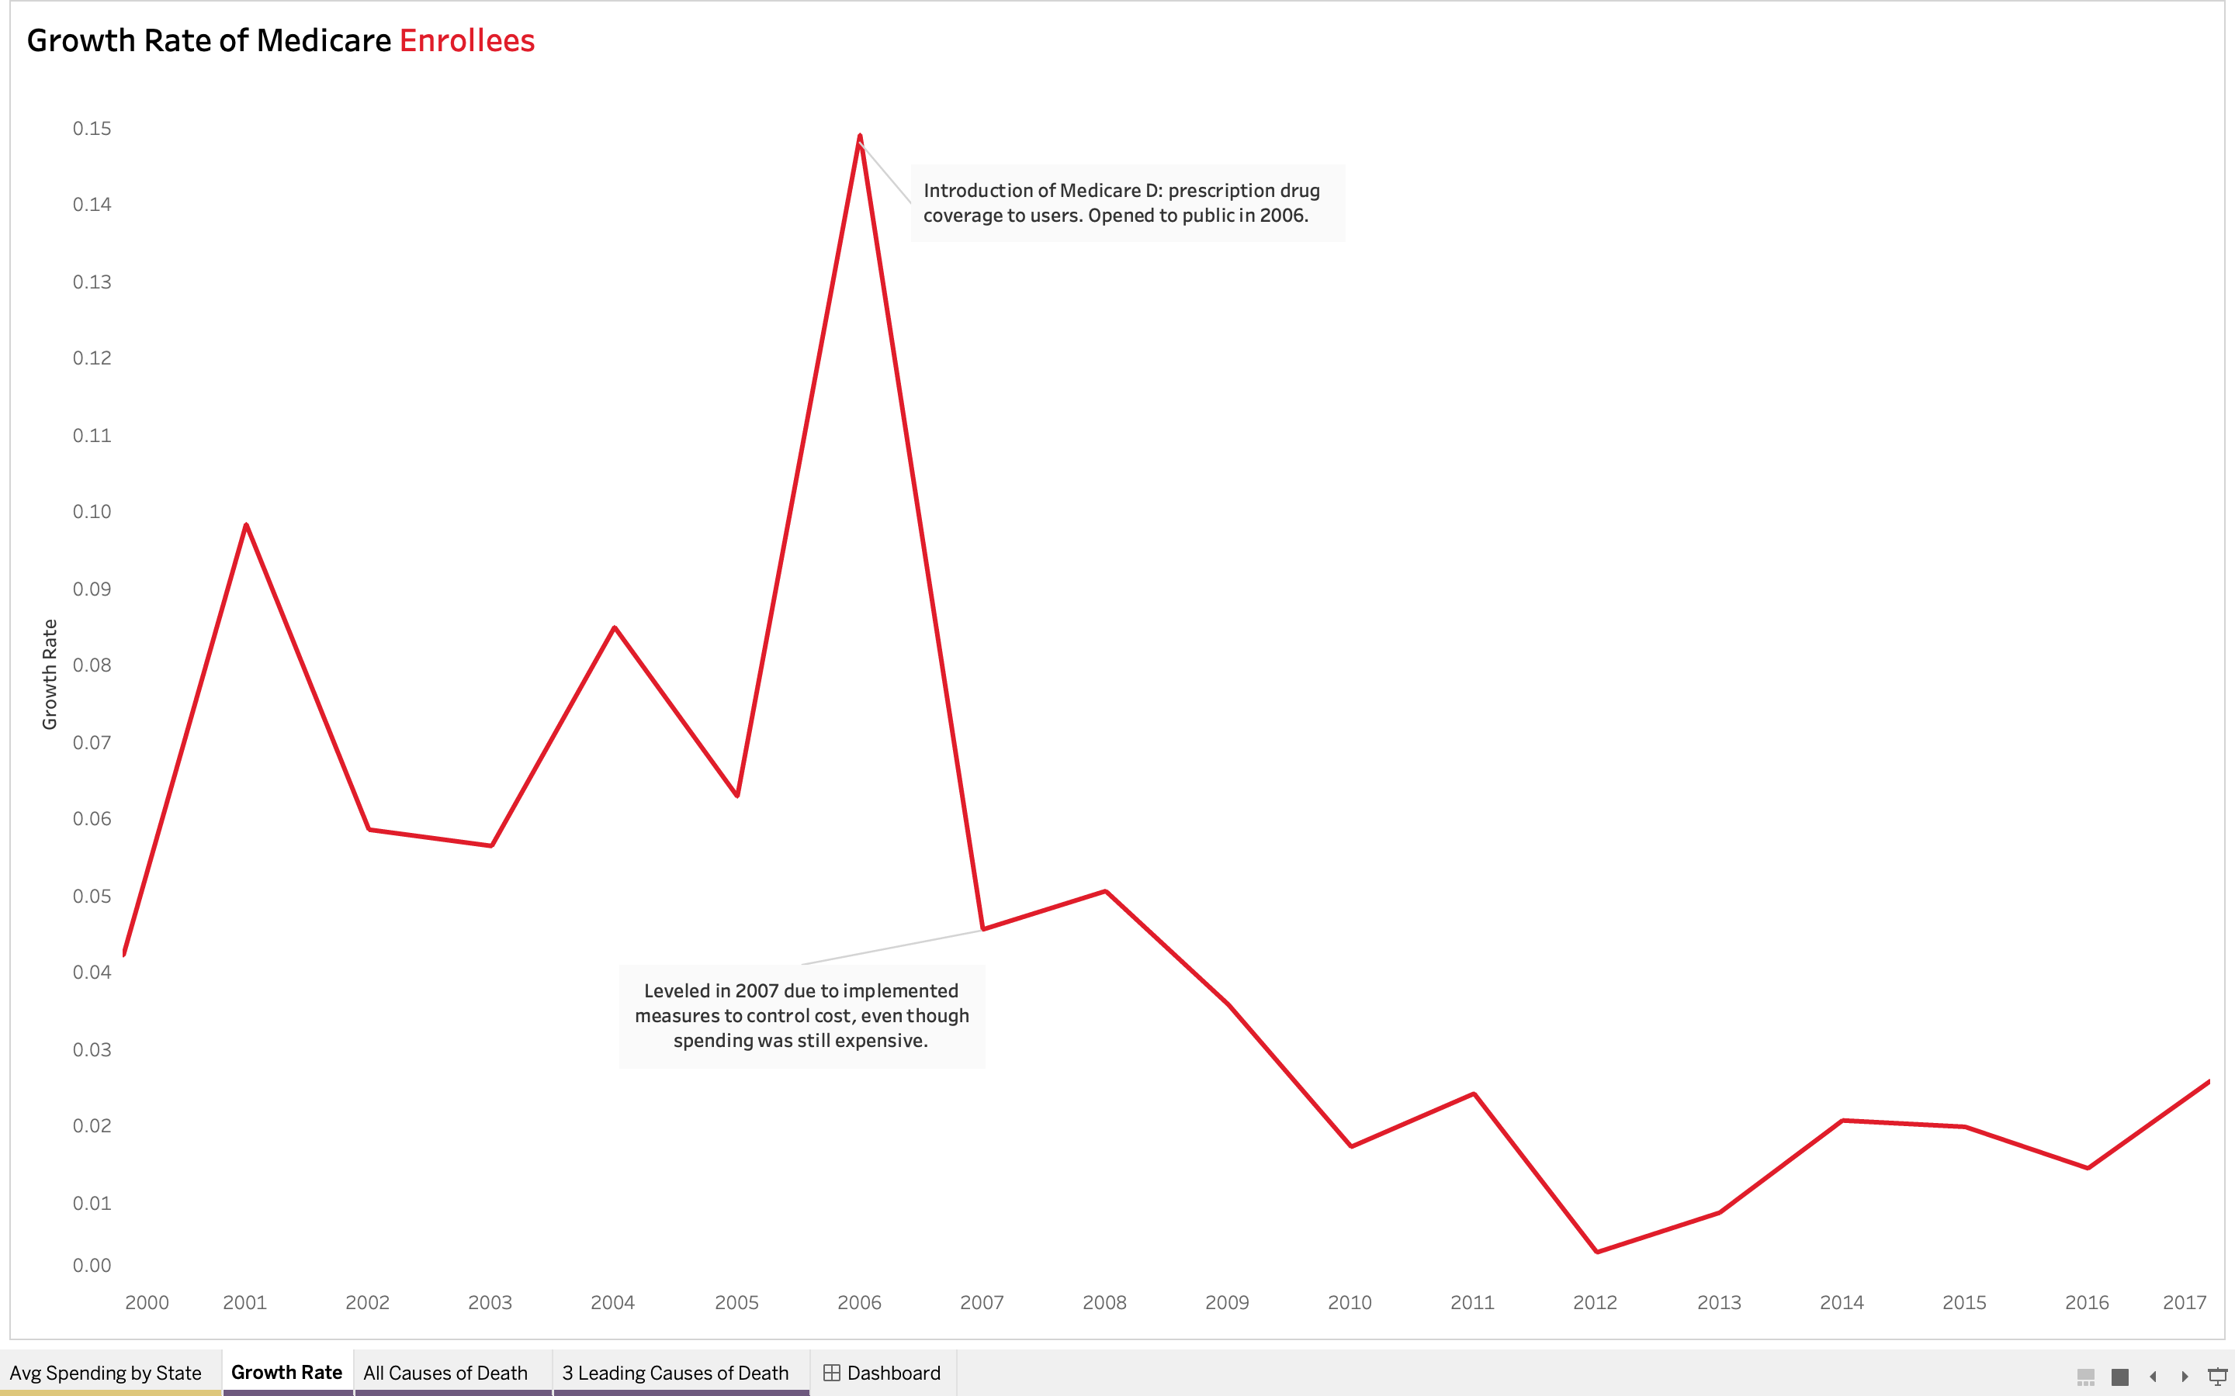
What are we doing now?
2006 Medicare Plan D
Year by year comparison
Slowly regaining spending per user
ACA 2012
Reduced spending
Due to changes in policy and inflation, is why we have spikes
Used calculated field to solve for growth rate over time

Slide 11
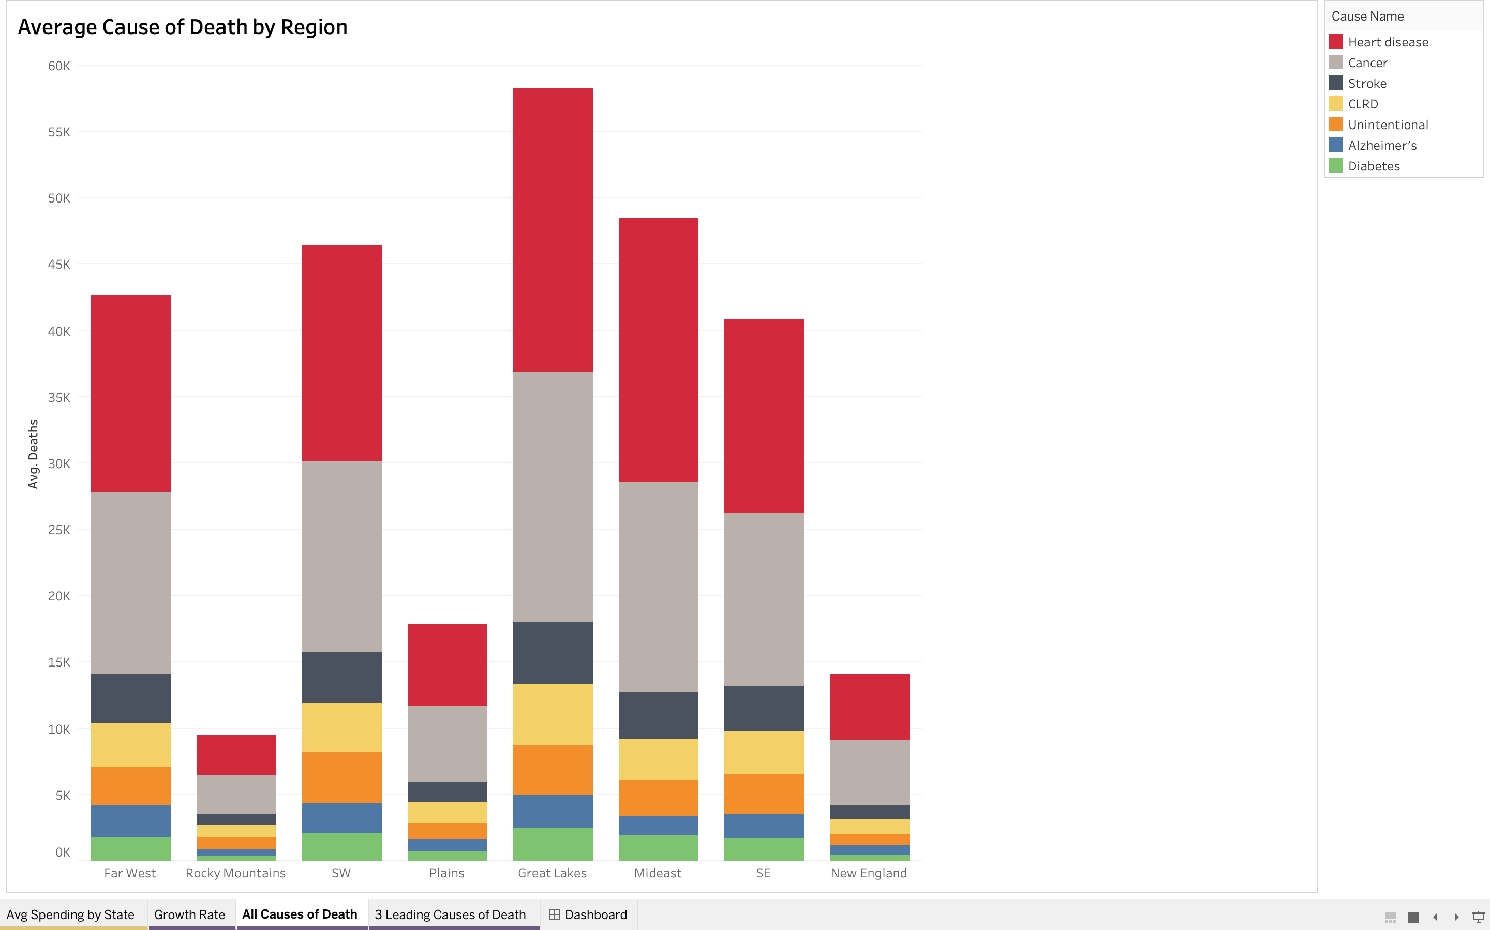
Medicare Analysis
Heart disease and cancer leading causes of death
East holds more cancer deaths
West​ holds little more heart disease deaths
Possibly due to environmental healthcare access from population

Slide 12
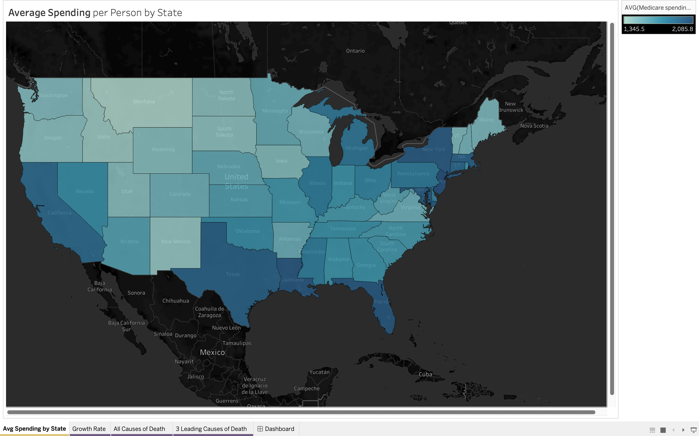
Correlation Analysis
High correlation to populated areas
Address causes of death and spending per enrollee by map
Given: west coast more heart disease, east coast more cancer
Due to environmental factors, or lifestyles
Medicare has low correlation to cause of death

Slide 13
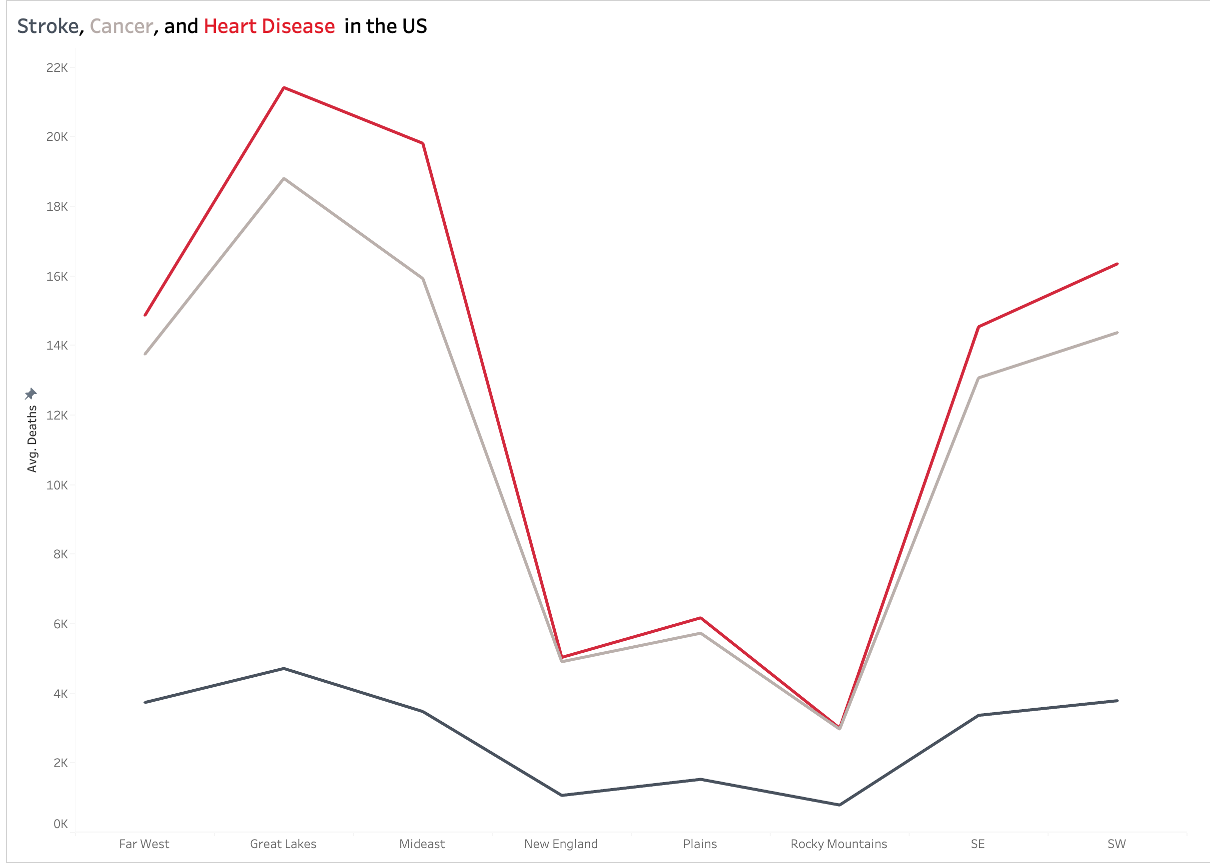
Leading Causes of Death
Top 3 causes of death
From before, heart disease and cancer deaths are bigger on both coasts of the US
More spending per user in those same areas
Very low correlation between Medicare and death
Could be because elder people are dying easier with old age

Slide 14
What needs to be done?
Smoking
Funding and continuing smoking prevention campaigns and education
Obesity
Creating policy to address food deserts and funding obesity education
Medicare and Medicaid
Address root causes and environmental factors of health
Combination of education and policies addressing environmental factors

Slide 15
Sources
NCHS, Leading Causes of Death in the United States 1999-2017
CDC, BRFSS Table of Smoking
CDC, BRFSS Table of Obesity
CMS Office of the Actuary, State Health Expenditure Data 1991-2020

